Slide 1

Introduction to Computer Vision
Extracting Semantic Meaning and Quantitative Structure from Pixels.
Dr. Ahmed Yousry

Slide 2
Foundations & AI Landscapes
Positioning computer vision within advanced computing, machine learning paradigms, and fundamental image-processing matrices.

Slide 3
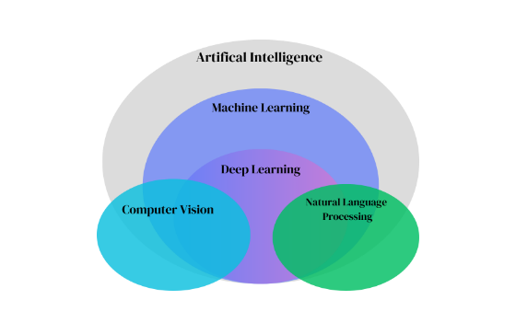

The Computer Vision Ecosystem
A Paradigm of Artificial Intelligence
Computer Vision (CV) functions as a crucial subset of Artificial Intelligence (AI) and Machine Learning (ML), interfacing deeply with robotics, autonomous systems, and NLP.
Nested Fields: Machine Learning and Deep Learning form the operational core of modern visual reasoning.
Interdisciplinary: Combines digital signal processing, neurological simulation, and mathematical optimization.
Practical Domains: Powers mission-critical components in autonomous driving, industrial robotics, and medical diagnostics.

Slide 4
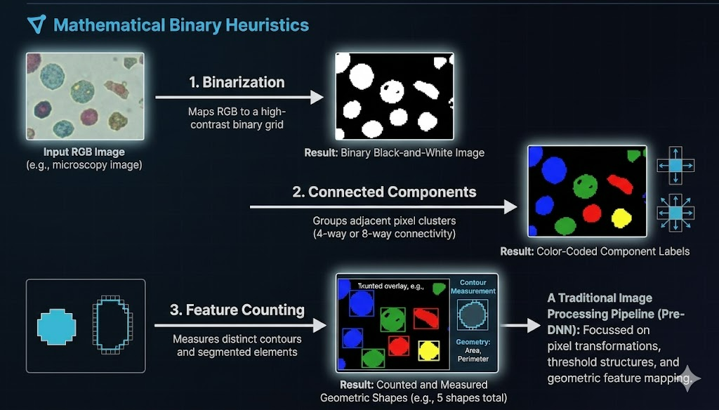
Traditional Image Processing Pipelines
Mathematical Binary Heuristics
Before modern deep neural networks, image processing focused on pixel transformations, threshold structures, and geometric feature mapping.
Binarization: Maps an RGB channel to a high-contrast binary black-and-white grid.
Connected Components: Groups adjacent pixel clusters using coordinate connectivity rules (4-way or 8-way).
Feature Counting: Measures distinct contours and segmented elements to count geometric shapes directly.

Slide 5
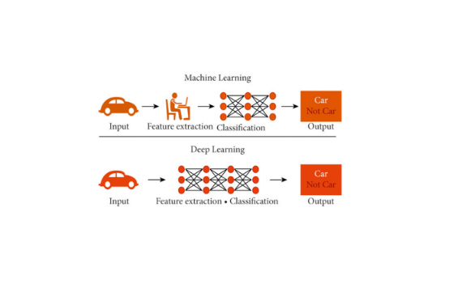
Machine Learning vs. Deep Learning
The Evolution of Feature Pipelines
The transition to deep representation learning removed human feature templates from the training loop entirely.
Classical ML: Requires engineers to hand-craft visual descriptor matrices (HOG, SIFT) before classifying with SVMs.
Deep Learning: Uses convolutional layer hierarchies to automatically detect raw edges, midpoint textures, and global semantic shapes.
Unified Grid: Merges features and classifier layers into an end-to-end backpropagation loop.

Slide 6
Core Computer Vision Fields
A detailed inspection of standard detection, tracking, reconstruction, and biometric analytical modalities.

Slide 7
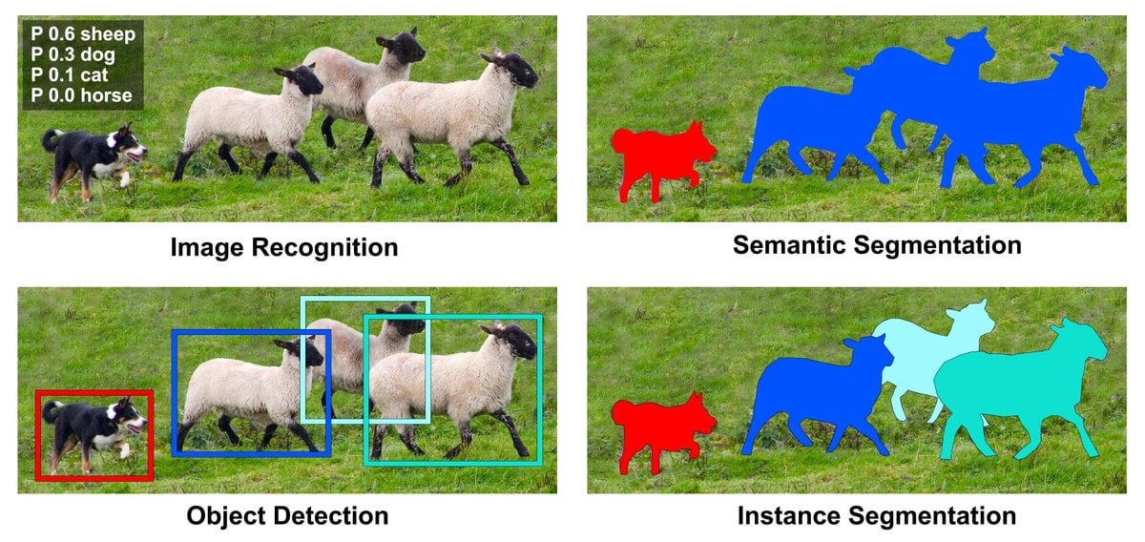
Classification, Detection & Segmentation
Understanding Spatial Resolution
Computer vision tasks are defined by their structural precision and spatial granularity across image grids.
Image Classification: Determines global image semantic categories (e.g., predicting a single "cat" label).
Object Detection: Draws bounding coordinates around individual visual targets.
Semantic Segmentation: Assigns labels to every pixel to outline clean silhouettes.

Slide 8
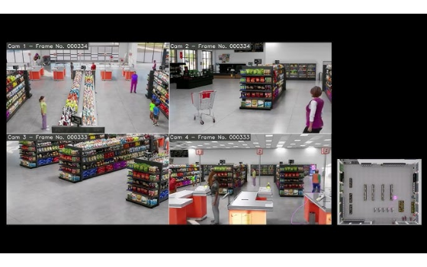
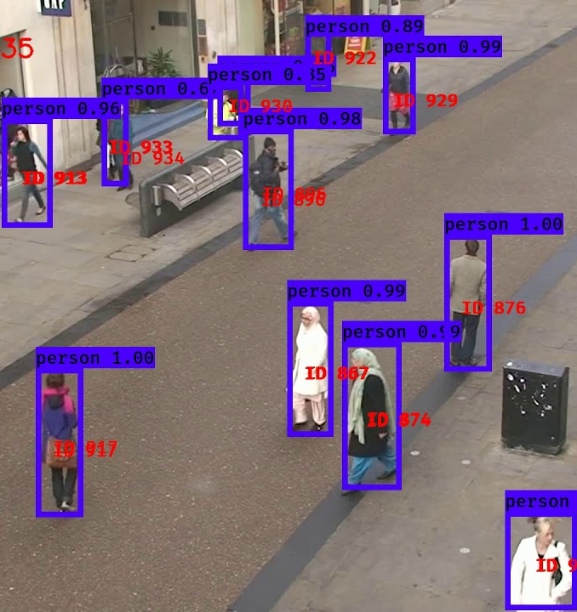
Multi-Object Video Tracking
Temporal Association Over Time
Object Tracking links localized detections across consecutive frames to maintain distinct identities over time.
Temporal ID Association: Connects bounding coordinates dynamically across changing frames.
Surveillance Monitoring: Vital for counting people, analyzing traffic, and detecting anomalies.
Algorithms: Combines Kalman Filters, Hungarian matching, and Deep SORT feature networks.

Slide 9
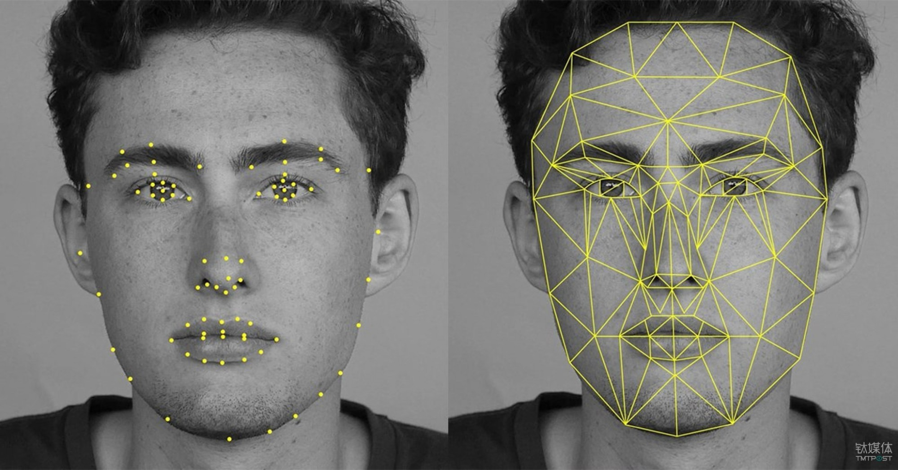
Biometrics & Face Mesh Landmark Tracking
High-Dimensional Coordinate Vectors
Face mesh trackers analyze facial topology in real-time, mapping coordinates to identify expressions and verify biometrics.
Dense Geometry Mesh: Fits hundreds of 3D virtual markers onto facial features like the mouth, nose, and eyes.
Biometric Verification: Calculates spatial ratios to accurately distinguish individual users.
Expression Analysis: Interprets deformation patterns to gauge user emotions in real-time.

Slide 10
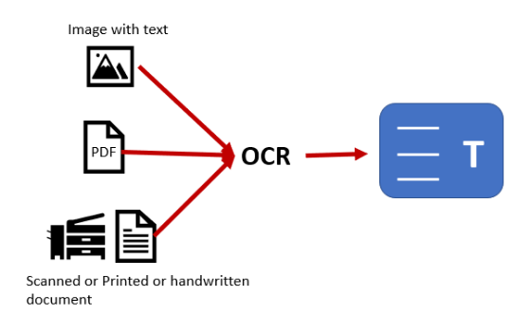
Optical Character Recognition
Translating Handwriting to Digitized Text
Optical Character Recognition (OCR) converts printed, typed, or handwritten letters into machine-encoded text streams.
Handwriting Challenges: Evaluates highly variable strokes and continuous cursive letters.
Text Layout Analysis: Segments document structures into zones, columns, lines, and individual characters.
NLP Integration: Feeds digitized text directly to downstream language models for automated parsing.

Slide 11
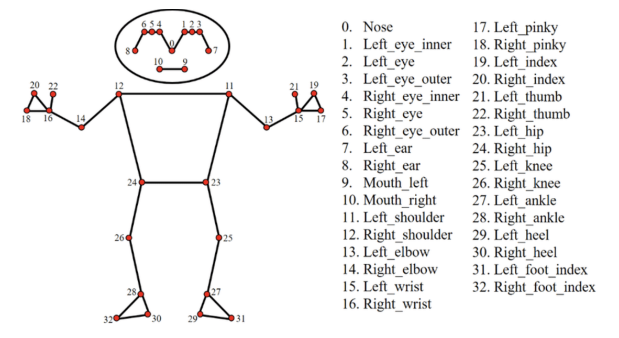
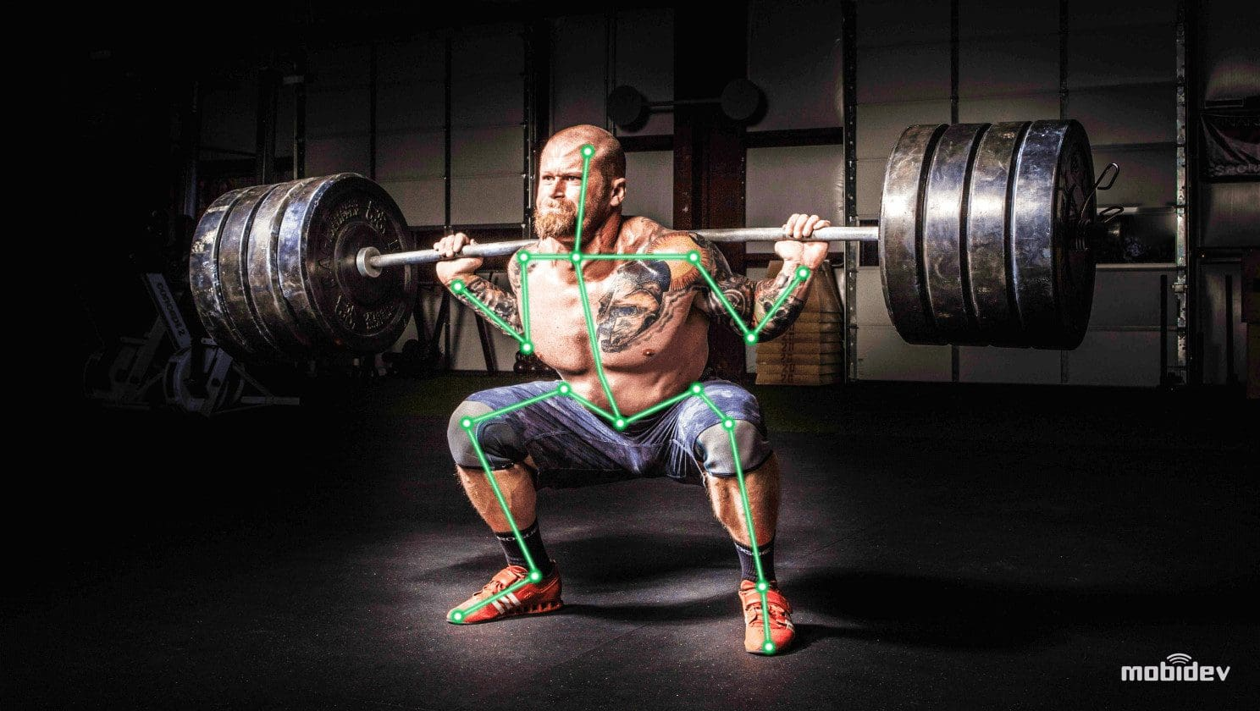
Human Pose Estimation & Biomechanics
Skeletal Keypoint Graph Mapping
Pose estimation models extract skeleton graph structures from human figures to monitor posture, actions, and movement mechanics.
Joint Coordinates: Isolates key human anatomical junctions (shoulders, elbows, knees, ankles).
Spatial Skeletal Graph: Connects extracted keypoints with coordinate vectors to model current posture.
Use Cases: Powers athletic analysis, gesture control systems, and clinical movement therapy.

Slide 12


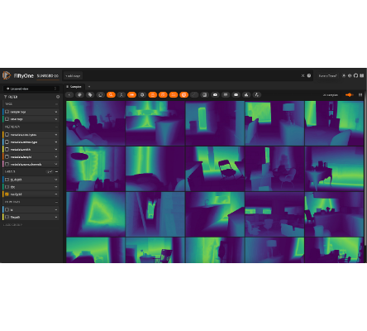
SPATIAL UNDERSTANDING
Depth Estimation
Measures the distance of objects in a 2D image to reconstruct a 3D environment mapping.
•
Essential for AR (Augmented Reality) placement.
•
Powering Robotic Navigation and collision avoidance.
•
Visualized through "Depth Heatmaps" where color indicates proximity.

Slide 13






ADVANCED AI TECHNIQUES
Zero-Shot Learning
Feature Extraction
Mask Generation
Detecting objects
the model was never trained on by using semantic relationships and general knowledge.
Converting visual patterns into numerical vectors for complex tasks like facial recognition and biometric security.
Automated isolation of subjects to create binary cutouts, enabling instant object removal or backdrop changes.

Slide 14
CV TASK SUMMARY TABLE
CV Task | Key Visual Output | Real-World Application
Image Classification | Single Subject Label | Automated Photo Sorting
Object Detection | Bounding Boxes | Traffic & Security Monitoring
Image Segmentation | Pixel-Level Mask | Medical Diagnostics & MRI
Depth Estimation | Distance Mapping | Autonomous Drone Navigation
Keypoint Detection | Skeleton/Landmarks | Fitness Tracking & CGI Mo-Cap
Feature Extraction | Mathematical Vectors | Facial Recognition Systems

Slide 15
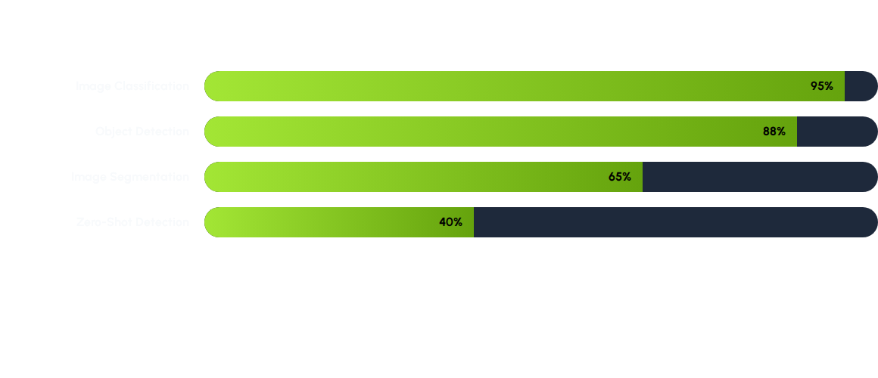
INDUSTRY ADOPTION RATE
*Estimated adoption based on current enterprise AI deployment trends.

Slide 16

The OpenCV Development Library
The Real-Time Processing Standard
OpenCV is the premier open-source tool for computer vision, offering highly optimized image processing functions.
C++ Core Backend: High-performance base framework wrapped in easy-to-use Python APIs.
Installation Setup: Run `pip install opencv-python` in your terminal to quickly start local development.
Versatility: Seamlessly handles file input/output, camera feeds, matrix math, and neural net execution.

Slide 17
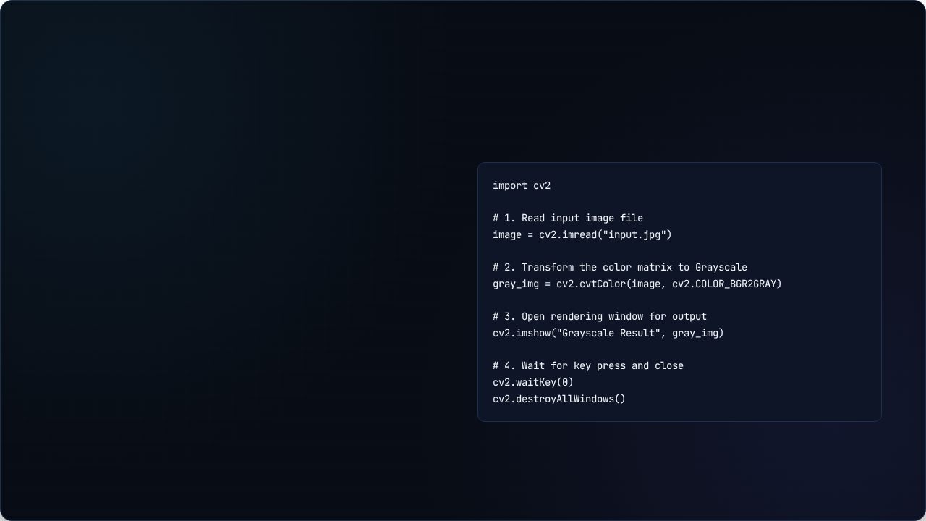
Writing Grayscale Transforms in OpenCV
Standard Pipeline Steps
A foundational OpenCV Python script that reads an image, transforms it to grayscale, and displays the output:
cv2.imread: Loads the file into memory as a NumPy matrix.
cv2.cvtColor: Transforms the BGR array into a single-channel grayscale matrix.
cv2.imshow: Opens a native rendering window to display the output.

Slide 18





Technical Asset Sources
AI Ecosystem Relationship Diagram
Source query: artificial intelligence computer vision machine learning deep learning relationship diagram
Connected Components Pipeline Step-by-Step
Source query: connected components labeling thresholding pipeline diagram
Feature Extraction vs Deep Learning Cat Classification Diagram
Source query: machine learning feature extraction vs deep learning end to end neural network cat classification diagram
Video Tracking Analysis Frame Overlay
Source query: multi object tracking camera surveillance frame
Handwritten Optical Character Recognition Steps
Source query: handwritten optical character recognition process diagram

Slide 19





Image Sources
https://osu-wams-blogs-uploads.s3.amazonaws.com/blogs.dir/2115/files/2024/12/Artifical-Intelligence-1.png
Source: blogs.oregonstate.edu
https://www.mdpi.com/sensors/sensors-25-03011/article_deploy/html/images/sensors-25-03011-g005-550.jpg
Source: www.mdpi.com
https://miro.medium.com/v2/resize:fit:1400/1*auECAV4SSFoSwVtl33mcaA.png
Source: medium.com
https://i.ytimg.com/vi/oBL84CeLwKk/hq720.jpg?sqp=-oaymwE7CK4FEIIDSFryq4qpAy0IARUAAAAAGAElAADIQj0AgKJD8AEB-AH-CYAC0AWKAgwIABABGGUgZShlMA8=&rs=AOn4CLBKuFskmNIhveFEyMS85C52WgkqWw
Source: www.youtube.com
https://www.labellerr.com/blog/content/images/2023/06/banner.webp
Source: www.labellerr.com

